Slide 1
Homework 5
YueLi
15620161152260

Slide 2
Q1、2
rm(list = ls())
library(RCurl)
library(XML)
library(bitops)
library(stringr)
url=paste(c("http://publicliterature.org/pdf/2ws1610.pdf","http://publicliterature.org/pdf/2ws2410.pdf","http://publicliterature.org/pdf/2ws3310.pdf") )
abs=lapply(url, FUN = function(x) htmlParse(x, encoding = "Latin-1"))
clean_txt = function(x) {
cleantxt = xpathApply(x, "//body//text()
[not(ancestor :: script)][ not(ancestor :: style)]
[not(ancestor :: noscript)] " ,xmlValue)
cleantxt = paste(cleantxt, collapse="\n")
cleantxt = str_replace_all(cleantxt, "\n", " ")
cleantxt = str_replace_all(cleantxt, "\r", "")
cleantxt = str_replace_all(cleantxt, "\t", "")
cleantxt = str_replace_all(cleantxt, "<br>", "")
return(cleantxt)
}
cleantxt = lapply(abs,clean_txt)
vec_abs = unlist(cleantxt)
vec_abs

Slide 3
library(tm)
library(SnowballC)
abs = Corpus(VectorSource(vec_abs))
abs_dtm = DocumentTermMatrix(abs, control = list(
stemming = TRUE, stopwords = TRUE, minWordLength = 3,
removeNumbers = TRUE, removePunctuation = TRUE))
dim(abs_dtm)
inspect(abs_dtm)
#Find the words that occur more than 5 times
findFreqTerms(abs_dtm, 5)
#Remove sparse terms
removeSparseTerms(abs_dtm, 0.5)
inspect(removeSparseTerms(abs_dtm, 0.5))
library(ggplot2)
library(wordcloud)
freq = colSums(as.matrix(abs_dtm))
wf = data.frame(word=names(freq), freq=freq)
plot = ggplot(subset(wf, freq>100), aes(word, freq))
plot = plot + geom_bar(stat="identity")
plot = plot + theme(axis.text.x=element_text(angle=45, hjust=1))
plot
freq = colSums(as.matrix(abs_dtm))
dark2 = brewer.pal(8, "Dark2")
wordcloud(names(freq), freq, max.words=200, rot.per=0.1, colors=dark2)
dev.off()

Slide 4
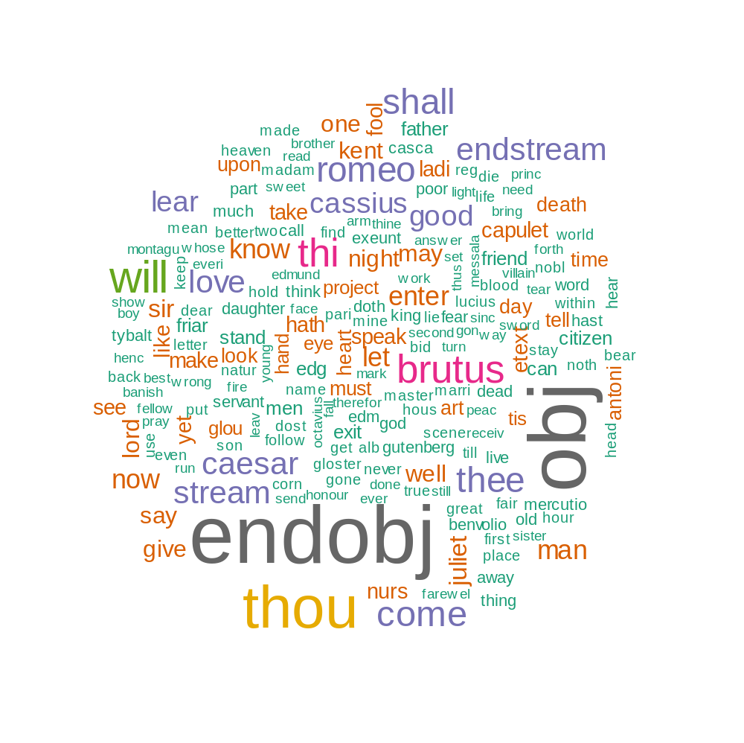

Slide 5
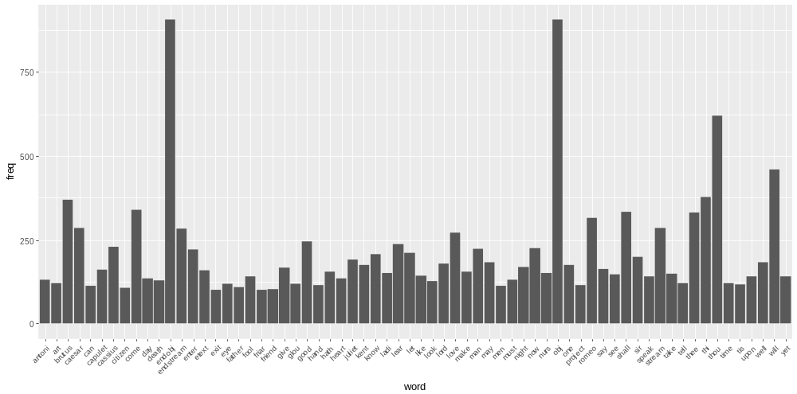

Slide 6
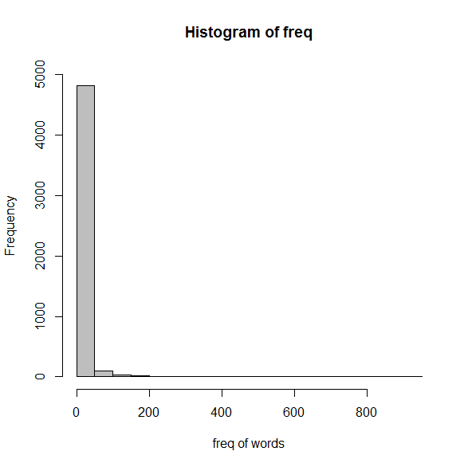
hist(freq, col = "grey", breaks = 20,ylim = c(0, 5000), xlab = "freq of words")

